Slide 1
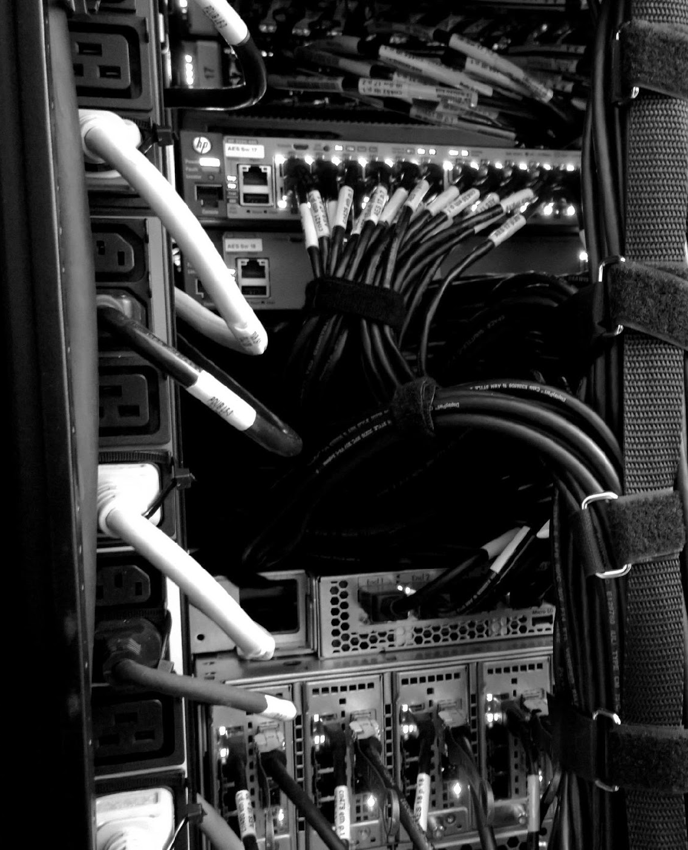

^{COMPUTEROME 2.0}
^{USERS WORKSHOP}
CENTER FOR HEALTH DATA SCIENCE (HEADS)
FACULTY OF HEALTH AND MEDICAL SCIENCES,
UNIVERSITY OF COPENHAGEN, FEBRUARY, 2021

Slide 2
^{PART1}
^{INTR DUCTION}

Slide 3


BACKGROUND
Users Include
Established in 2014, The Danish National Life Science Supercomputing Centre, Computerome, is a High-Performance Computing (HPC) facility specialised and securely optimised for life science research.
Our users benefit from the fast, flexible and secure infrastructure and the ability to combine different types of sensitive data and perform analysis.
Research groups from all Danish universities
Large international research consortiums
Those in the public health care sector
Industry

Slide 4
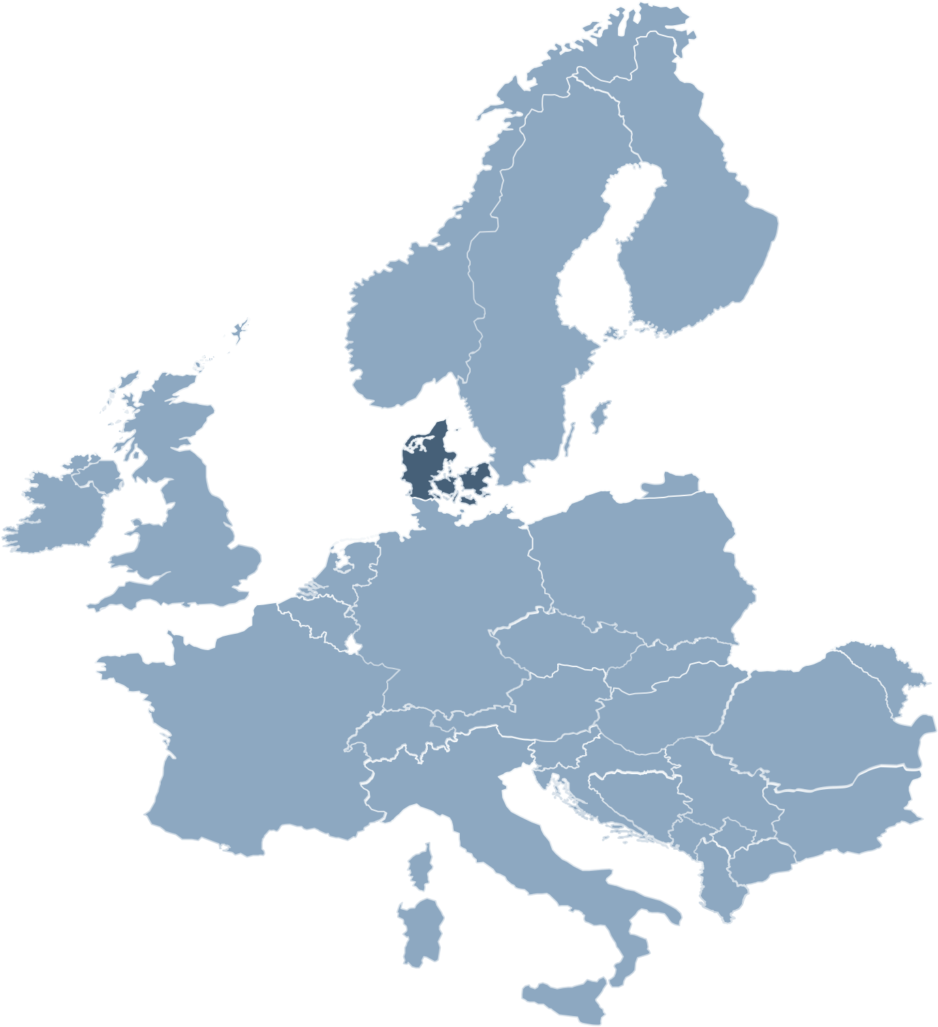


MISSION
Computerome’s primary focus is dedicated to Life Sciences offering a cutting-edge secure infrastructure, software and scientific tools that are a first-choice for research and clinical users.
Key offerings:
Large international research consortiums
Security
Compliance
Public
Customized Capabilities
Automation Features
User-Driven Development
Notes:
Security – more secure than anyone else in the public sector. The research projects running on Computerome 2.0 involve in many cases highly sensitive and valuable data, and data are stored and processed with security and data protection as key priorities.
Compliance - the procedures and guidelines in Computerome have received a rating of 100% compliance, based on the ISAE-3000 framework
Innovation and development is in the core of Computerome’s mission.

Slide 5

PURPOSE
Being one of the world’s most powerful supercomputers dedicated to Life Science research, Computerome plays a vital role in undertaking ambitious research projects, among others in personalised medicine and in the development of new drugs. Computerome 2.0 meets the current and future increasing demands for secure and faster computing capacity of vast data volumes required by the research communities.

Slide 6
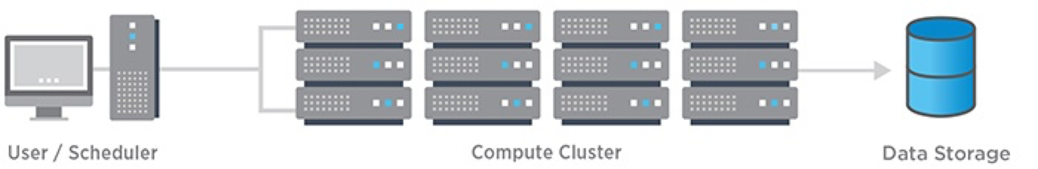
HIGH-PERFORMANCE COMPUTING SYSTEM
An HPC cluster consists of hundreds or thousands of compute servers that are networked together.
Each server is called a node. The nodes in each cluster work in parallel, boosting processing speed to deliver high-performance computing.
!! ONLY run jobs on a HPC when you can’t run it anywhere else.

Slide 7
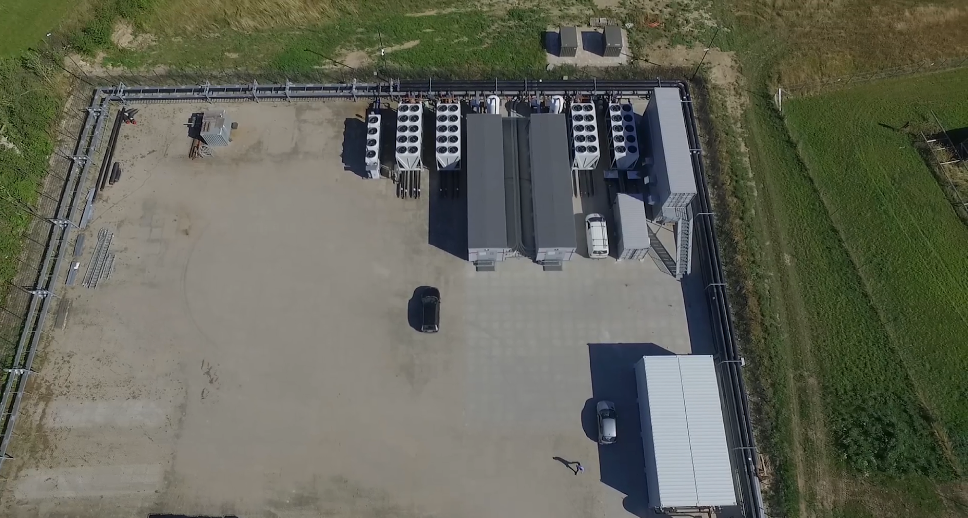




Slide 8
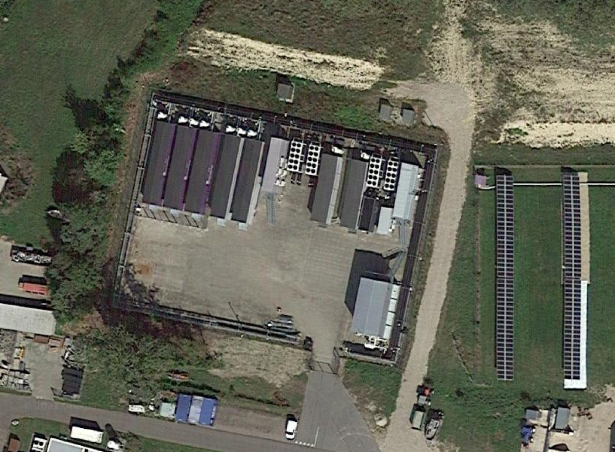

Slide 9
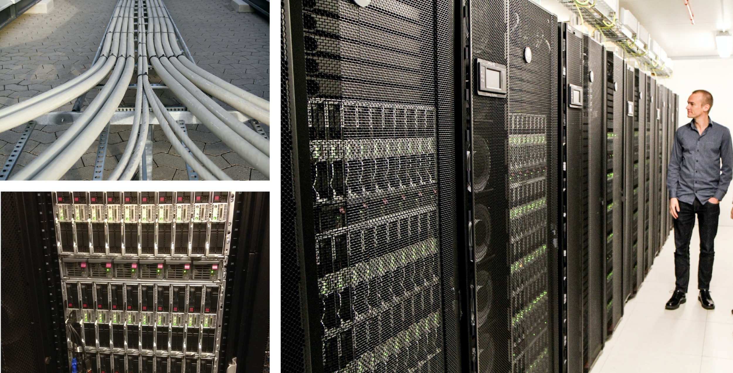

Slide 10

Hardware systems
CPUs, GPUs, storage, secure cloud…
Supports different programming languages
C, Fortran, Python, R…
Parallel programming paradigms
Algorithms, shared memory and distributed memory parallelism
Software tools
Modules, applications, schedulers, debugging tools, etc.
HIGH-PERFORMANCE COMPUTING

Slide 11
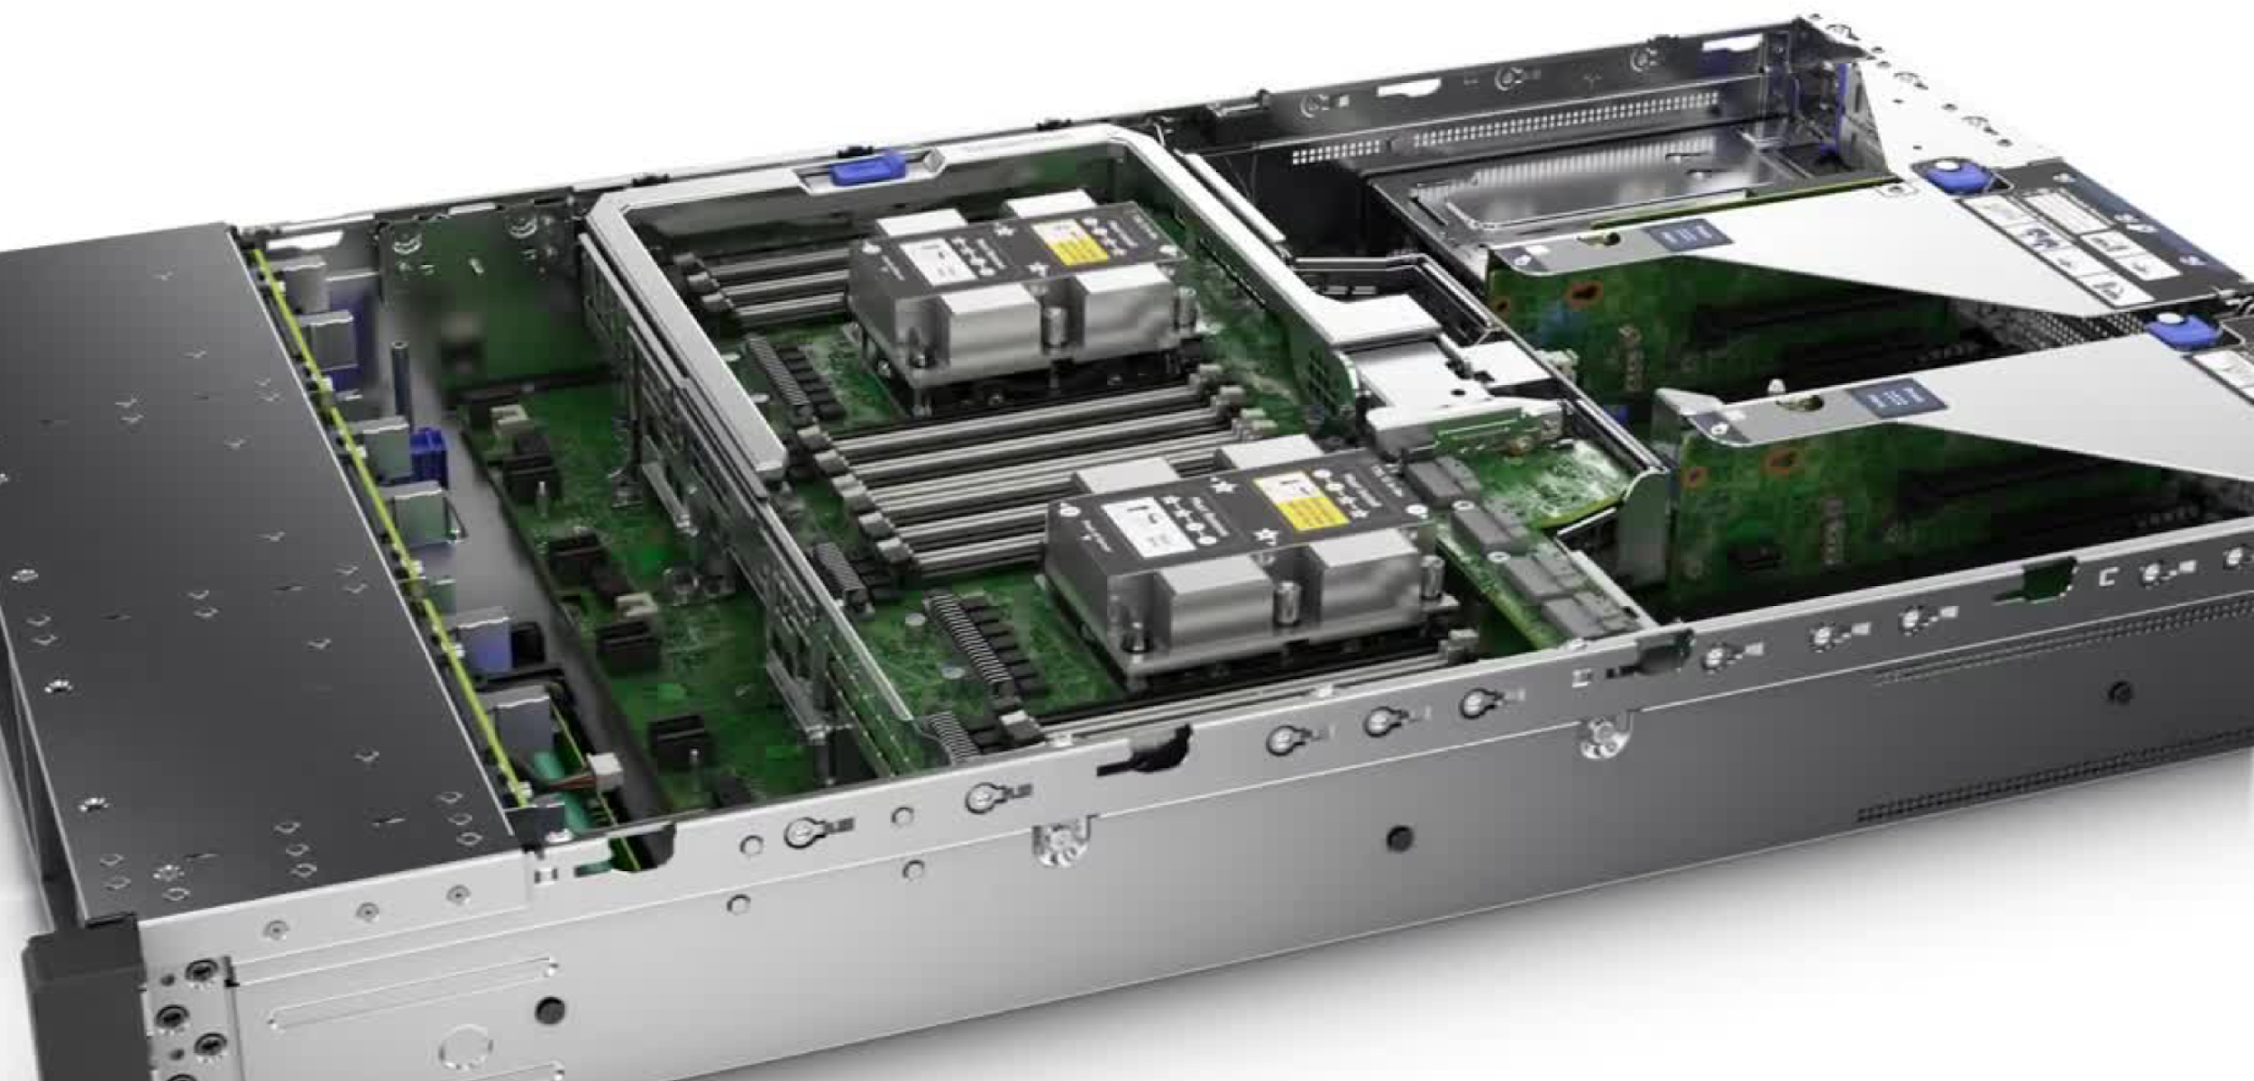
When working in a HPC environment it is important to differentiate between nodes, processors and cores as these terms are often used interchangeable.
Nodes: The physical server. Each node will consist of multiple processors, shared memory and other hardware.
Processor: This is the Central Processing Unit (CPU), each having one or more core.
PPN: Term used when scheduling job and describes the number of booked processors per node.
Cores: This is the actual computation unit of the CPU
Nodes, Processors and Cores

Slide 12
TYPICAL HPC CLUSTER ARCHITECTURE
www
User interface / login node
Modules / applications
Libraries
Access to storage
High speed network switch
Cluster middleware
Compute Nodes
Storage
v

Slide 13
COMPUTE ARCHITECTURE
Category | # of Nodes | Type | # of CPU | Cores/CPU | Cores/node | # of Cores | Memory
Thin nodes | 692 | 2 x HPE XL190r Gen10 Xeon-Gold 6230 (2,1 GHz/20 core/125W) Processor kit | 2 | 20 | 40 | 27.680 | 192 GB
GPU nodes | 40 | 2 x HPE XL190r Gen10 Xeon-Gold 6230 (2,1 GHz/20 core/125W) Processor kit | 2 | 20 | 40 | 1.600 | 192 GB
Fat nodes | 55 | 2 x HPE DL360 Gen10 Xeon-Gold 6230 (2,1 GHz/20 core/125W) Processor kit | 2 | 20 | 40 | 2.200 | 1.536 GB
Login nodes | 3 | 2 x HPE DL380 Gen10 Xeon-Gold 6230 (2,1 GHz/20 core/125W) Processor kit | 2 | 20 | 40 | 120 | 192 GB
Database nodes | 3 | 2 x HPE DL360 Gen10 Xeon-Gold 6230 (2,1 GHz/20 core/125W) Processor kit | 2 | 20 | 40 | 120 | 192 GB
Web Service nodes | 4 | 2 x HPE DL360 Gen10 Xeon-Gold 6130 (2,1 GHz/16 core/125W) Processor kit | 2 | 16 | 32 | 128 | 192 GB
Head nodes | 2 | 2 x HPE DL360 Gen10 Xeon-Gold 6230 (2,1 GHz/20 core/125W) Processor kit | 2 | 20 | 40 | 80 | 192 GB
Total | 799 |  |  |  |  | 31.928
Note the difference between the thin and fat nodes in terms of amount and memory
Don’t block a fat node unless you need more than 192 GB of memory

Slide 14
COST FOR COMPUTE AND STORAGE
COMPUTEROME 1 | COMPUTEROME 2
Features
CPUs per node: 28/32 | CPUs per node: 40
Memory per thin node: 125gb | Memory per thin node: 192gb
Memory per fat node: 1000gb | Memory per fat node: 1536gb
8PB storage | 11.4PB storage
Snapshot backup | Snapshot backup (cd .snapshot in any directory)
Pricing
Storage: DKK 250 /TB | Storage: DKK 91,70 /TB
DKK 3,08 / thin node hour DKK 3,52 / fat node hour | DKK 3,87 / CPU node hour DKK 6,46 / GPU node hour
Note the difference in CPU setup from C1 to C2 (in case you inherit old C1 scripts)
You are always charged for a full node
Storage cost are calculated as the highest peak per month

Slide 15
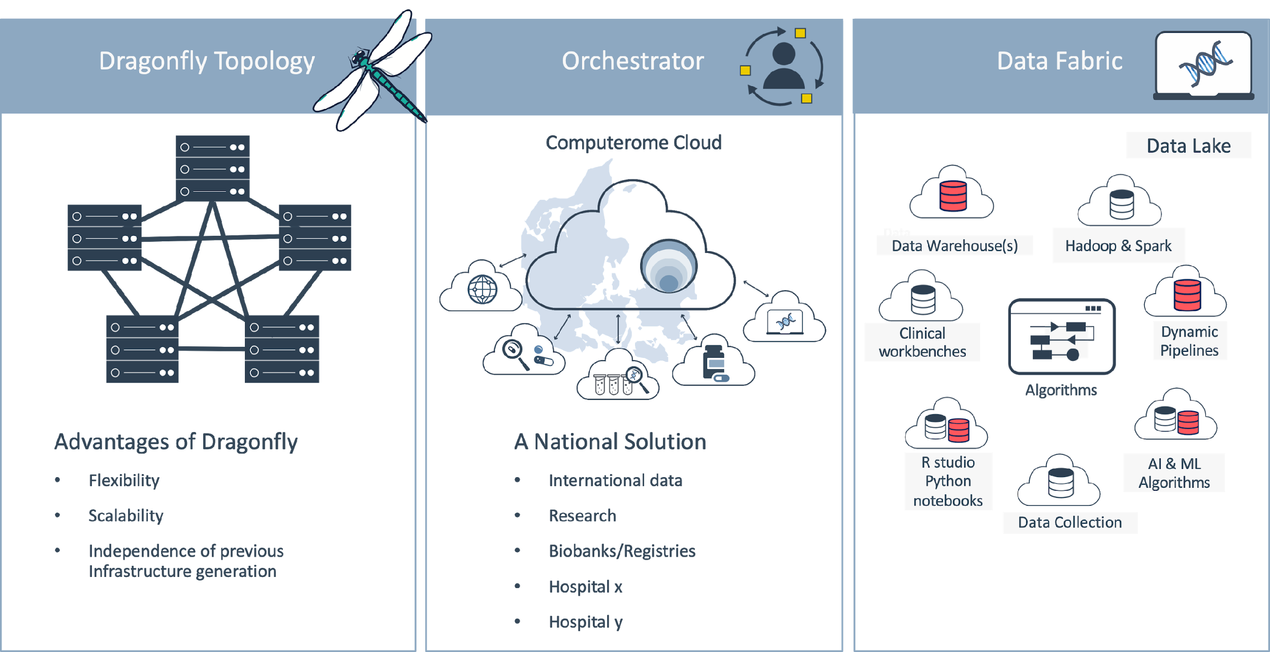
ARCHITECTURE FOR COMPUTEROME 2.0

Slide 16
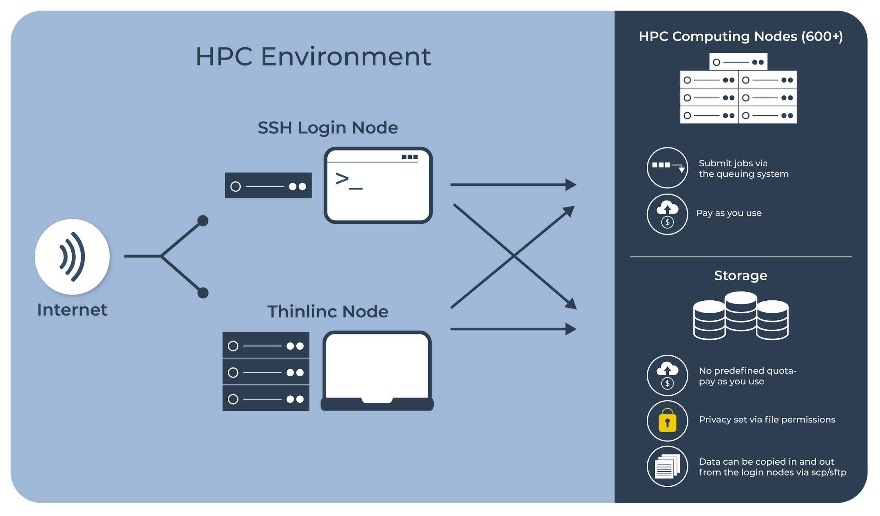
COMPUTEROME HPC ENVIRONMEMNT

Slide 17

SECURE PRIVATE CLOUD
The Computerome Secure Private Cloud is a Platform-as-a-Service providing the user with a private and dedicated virtual supercomputer, configured and optimised to meet the user’s specific needs, special requirements and workload.
Working with health data, sensitive personal data or working with high-value research or confidential data, the Secure Private Cloud is the optimal choice for health care and life science research users.
The Secure Private Cloud is a 100% containment of the data, users and compute resources within

Slide 18
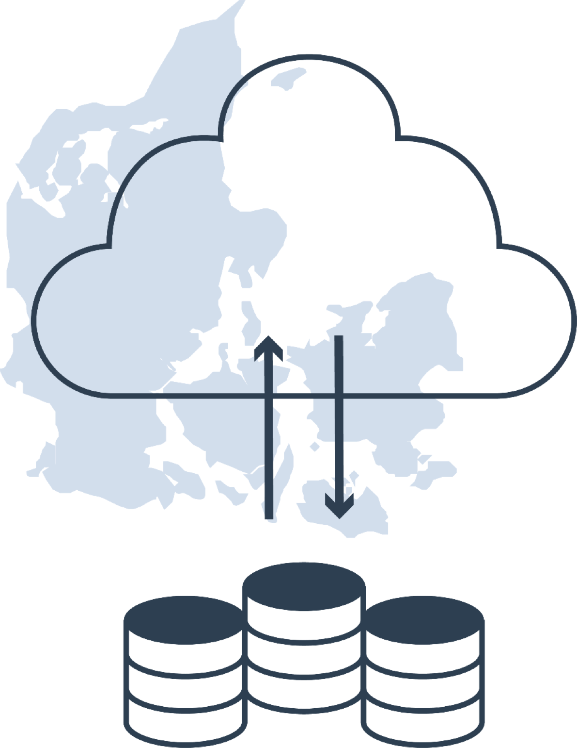
WORKING ON C2 SECURE PRIVATE CLOUD (SPC)
Storing and processing person-sensitive data
100% scalable compute resources
Storage and recovery of very large data sets
3,000+ bioinformatics/scientific tools and databases
Physically isolated cloud with 5 layers of security
Expert 1-to-1 support & system admin services
31.360 Cores
220 TB Memory
17 PB Storage

Slide 19
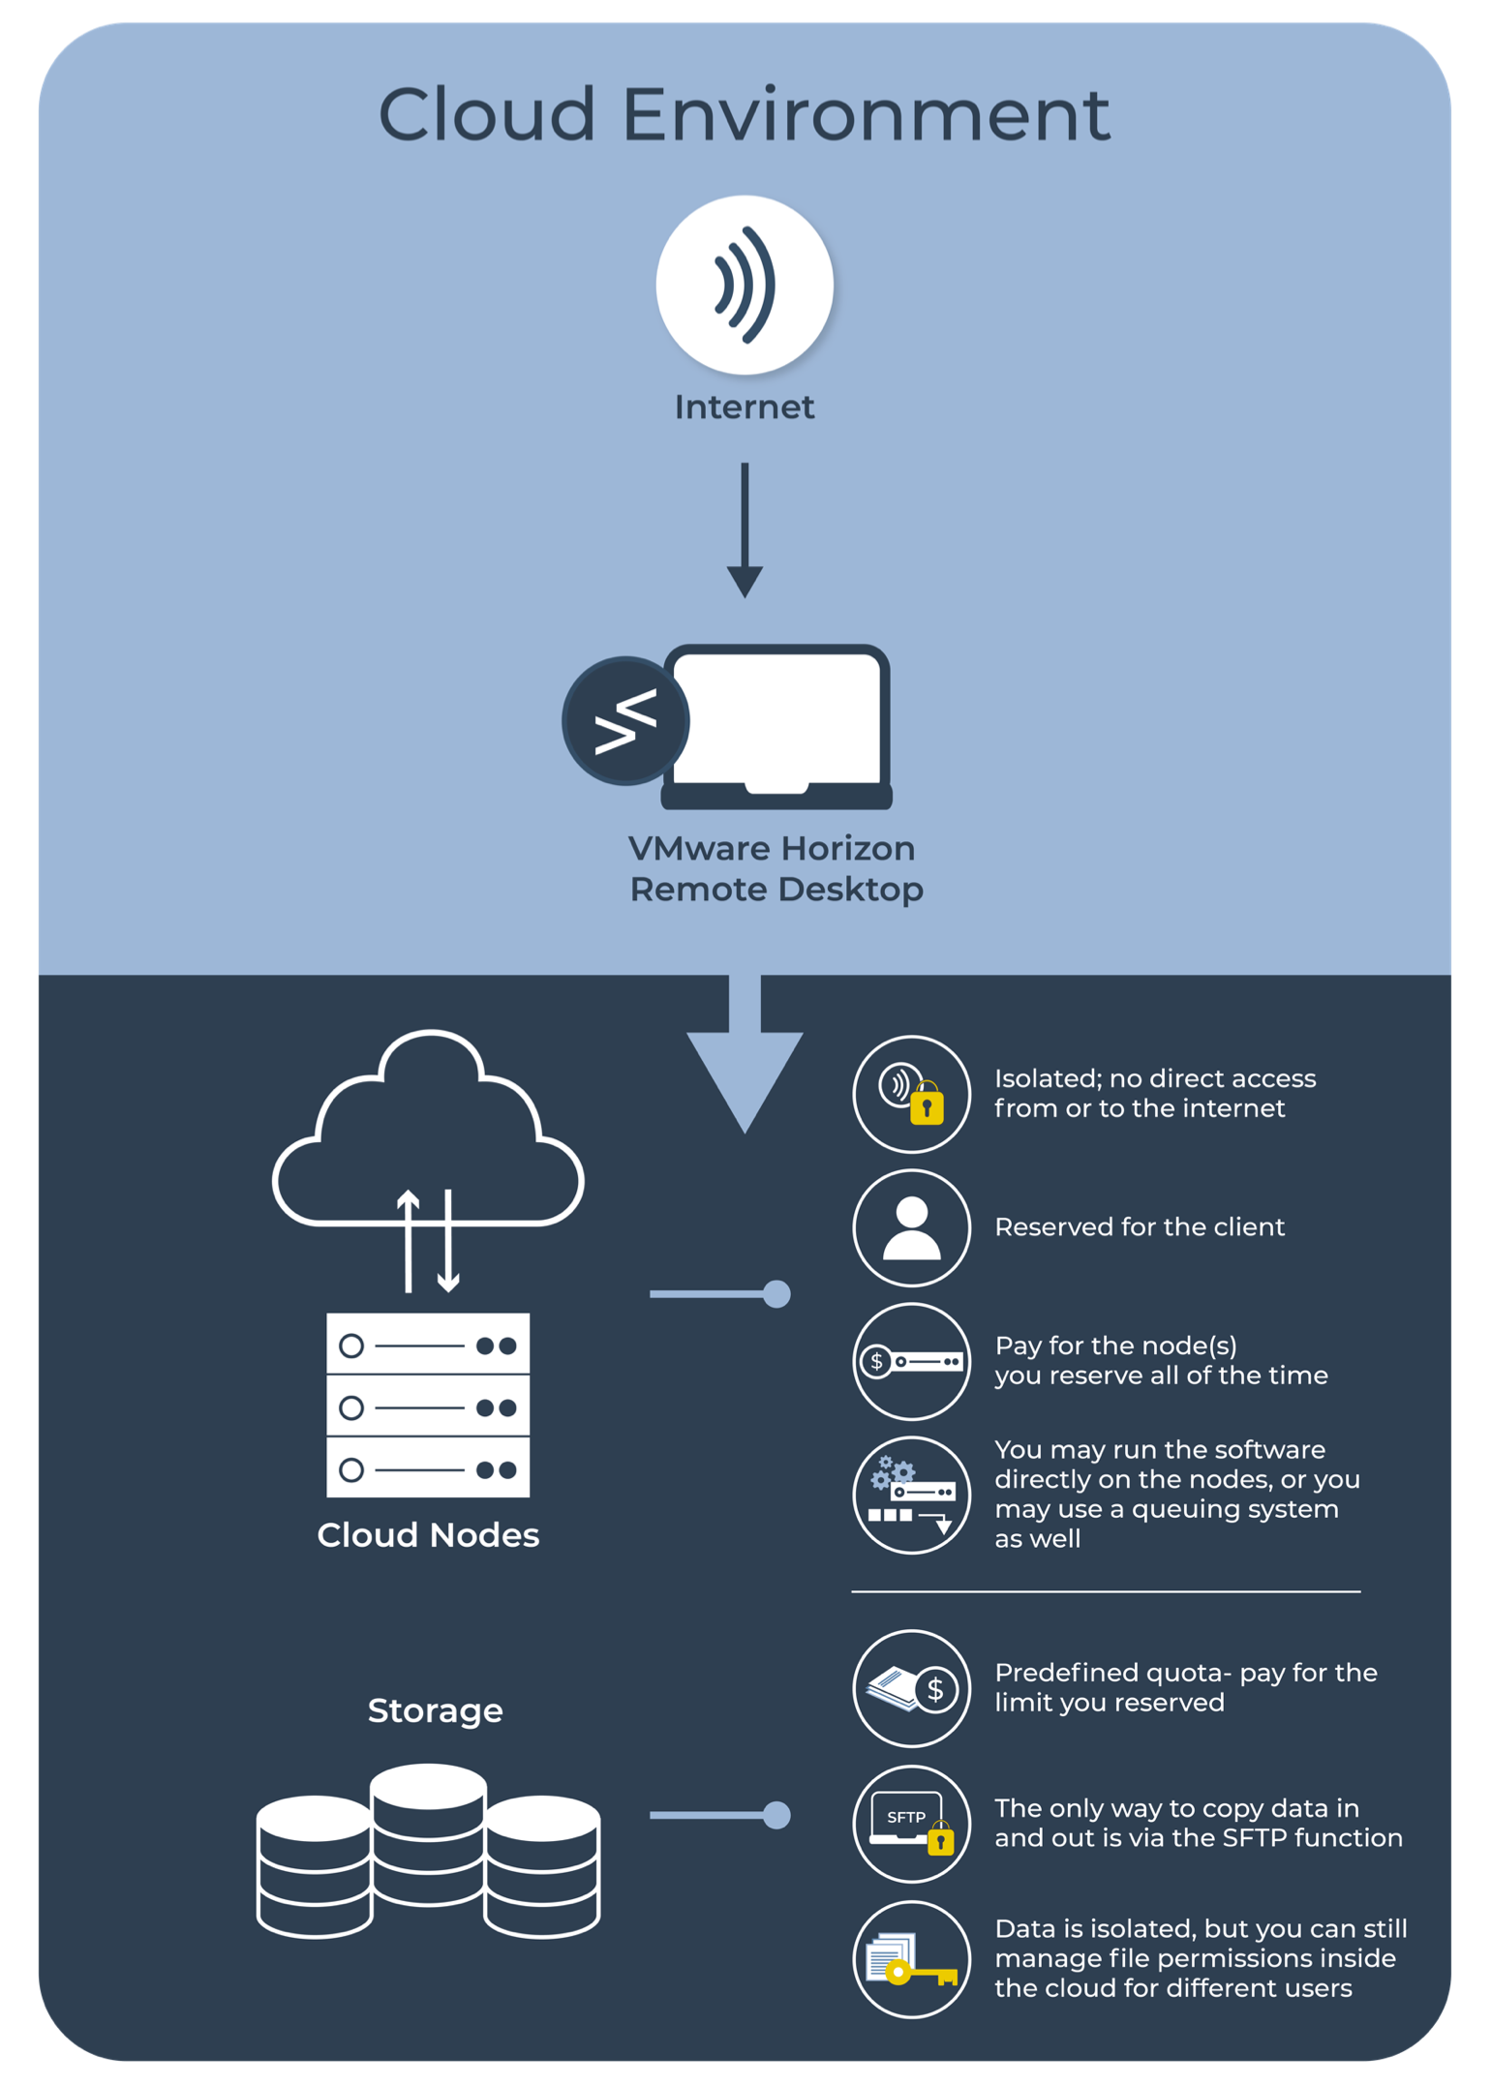
CLOUD ENVIRONMENT

Slide 20
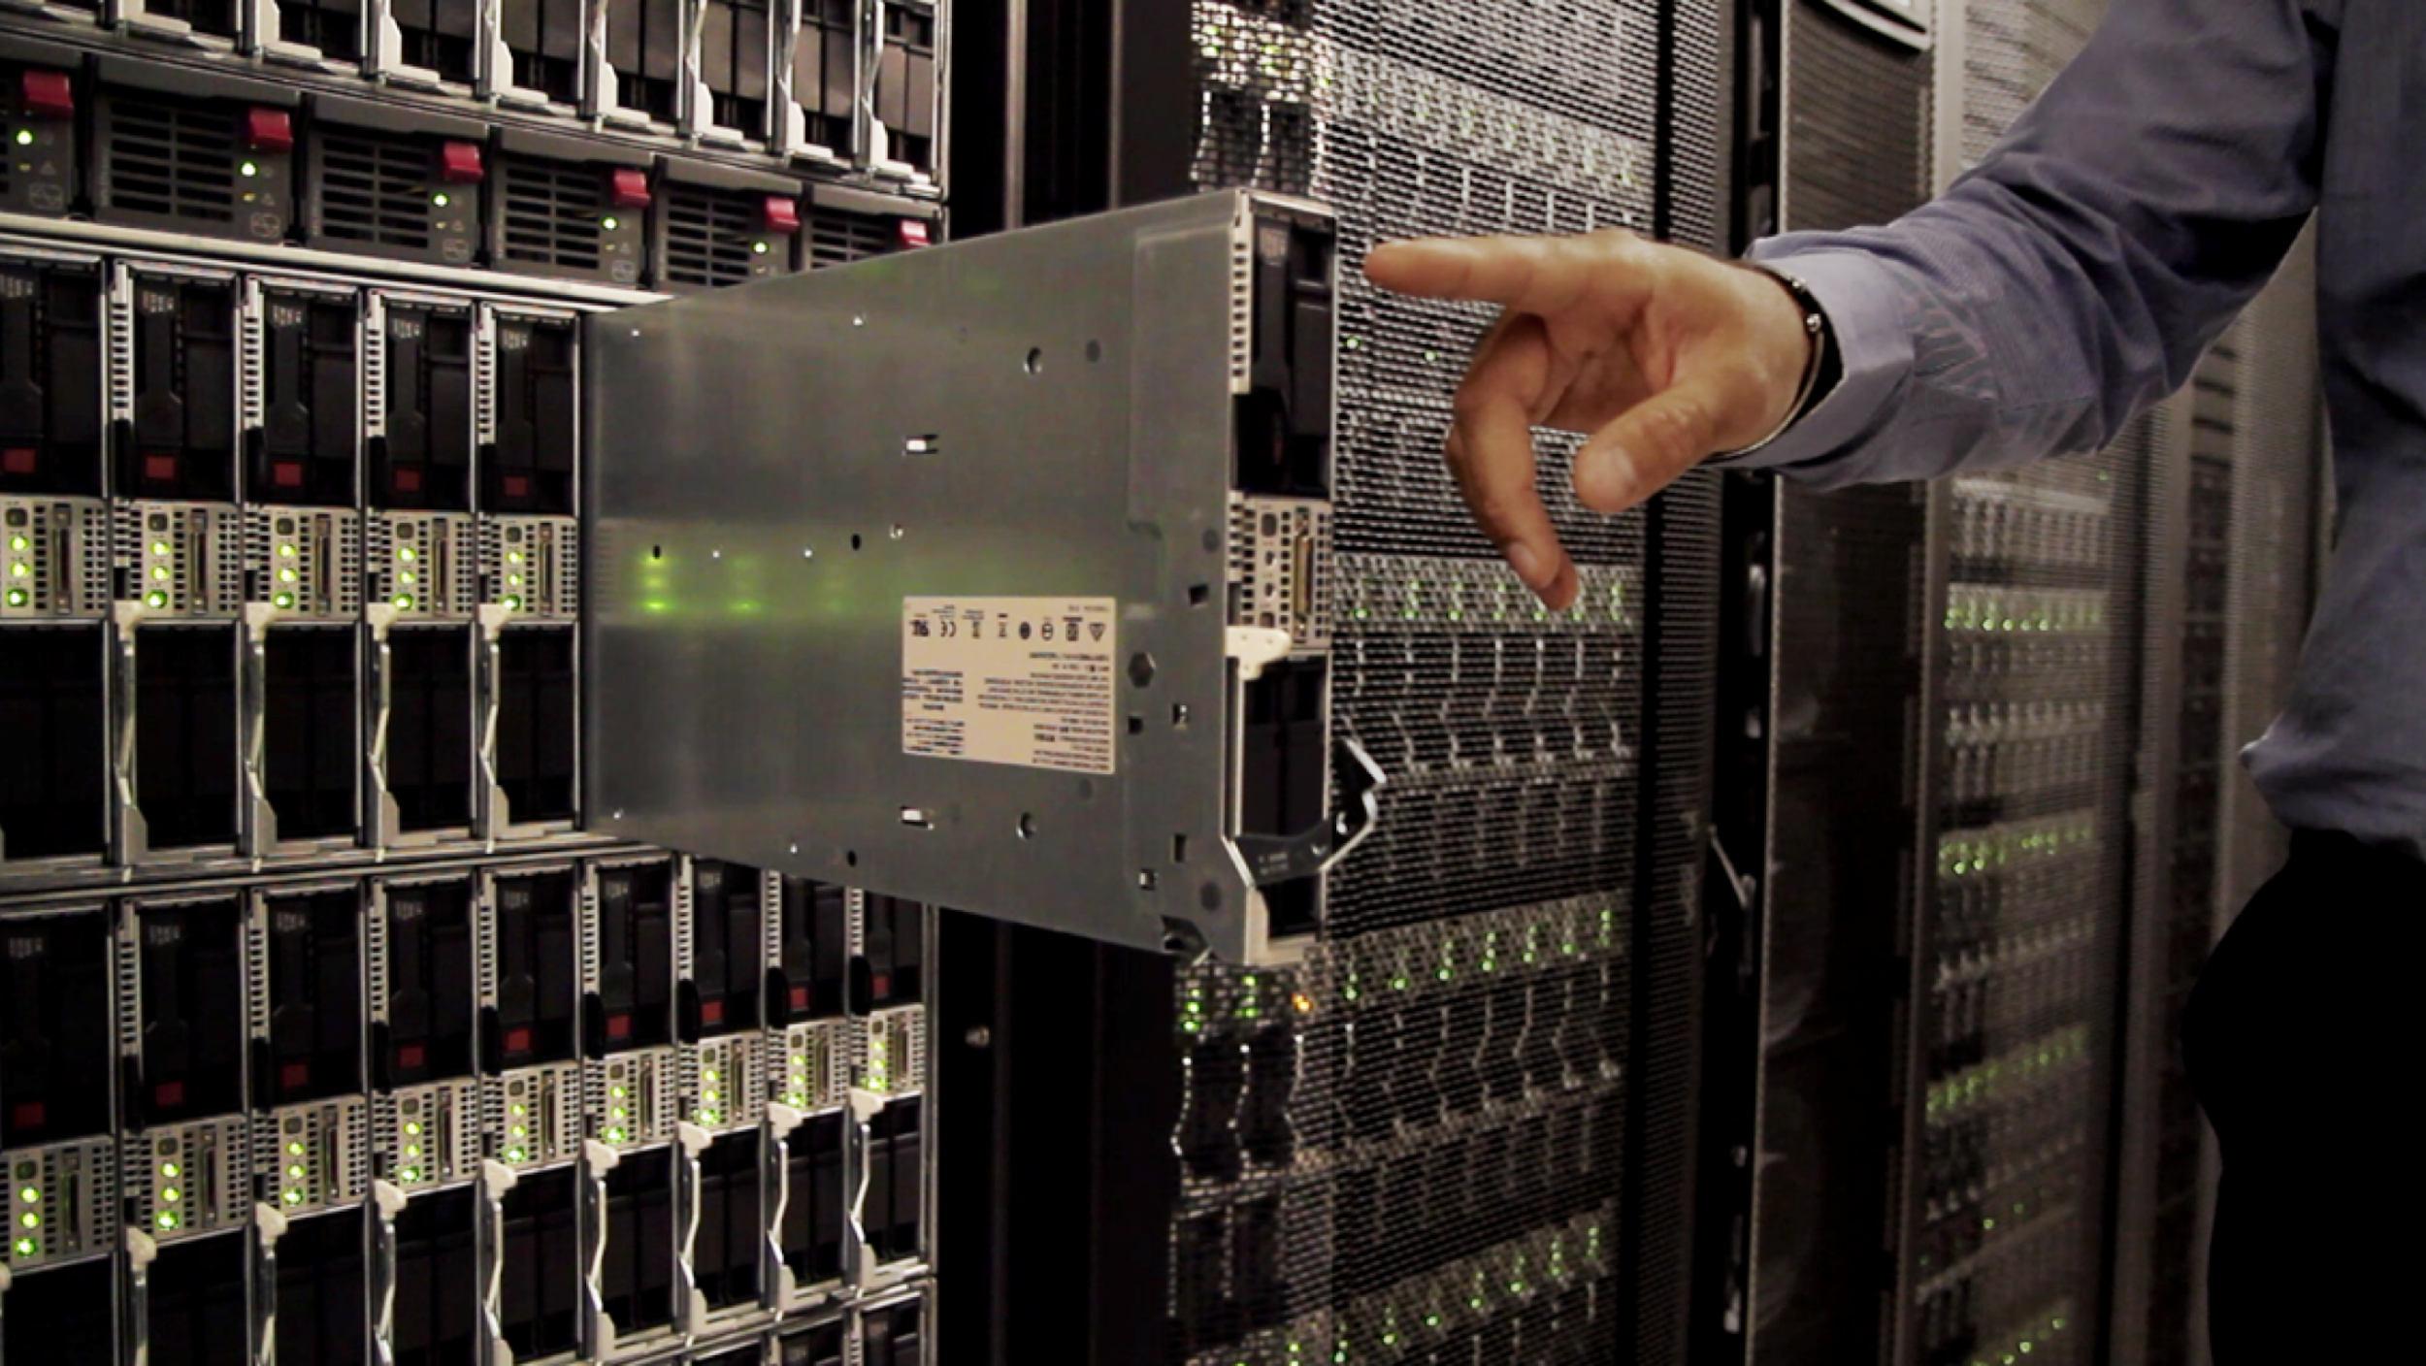

SECURITY AND COMPLIANCE

Slide 21


COMPUTEROME 2.0 SPC SECURITY MODEL
2 Factor Authentication
Computer Firewall
5 LAYERS
C2 SPC Firewall
Physical & Digital Security
ID and Access Management
Security by Design

Slide 22
QUESTION TIME
Which type of analysis would you run at a supercomputer?
2 min individual reflection
Plenum discussion

Slide 23
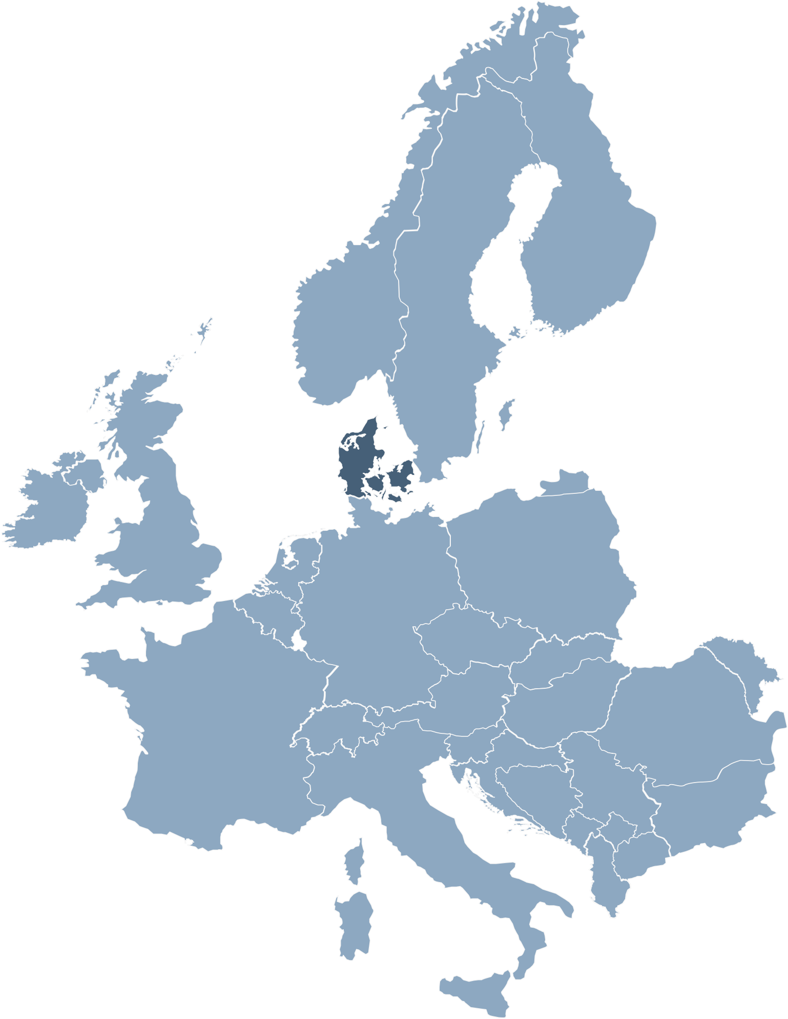

SECURE PRIVATE CLOUD CONTACT
For further information or inquiries about Computerome and Secure Private Clouds, please write to us at:
Computerome@dtu.dk
Computerome.dk
We will be happy to assist you.

Slide 24

COMPUTEROME COMPLIANCE
As per Aug. 31’st 2020, the procedures and guidelines in Computerome have received a rating of 100% compliance, based on the ISAE-3000 framework. The assessment, which was conducted by the external consultancy firm PWC, encompasses the following main areas:
Organizational measures, which include legal processing of data, and management of legal contracts with all stakeholders including clients and sub-processors
Management of employees, including background check, employment contracts and code of conducts
Physical security of the facilities
Technical measure to secure the IT system
ISAE-3000 = 100% compliance framework

